Slide 1

Attitude estimation of a Smartphone using Sensor Fusion
MEEN 689
Kartik Prakash
Aditya Bhardwaj
Daniel Jaeger
Mukund Viswanathan

Slide 2
Problem Overview
Attitude estimation of smartphone using embedded gyroscope, accelerometer and magnetometer
Sensor data is streamed from PhonePi app, and is imported to ROS to perform computations and visualize motion of the phone
The sensors information is fused to reduce the individual uncertainty from each sensor, using a complementary and kalman filter.

Slide 3
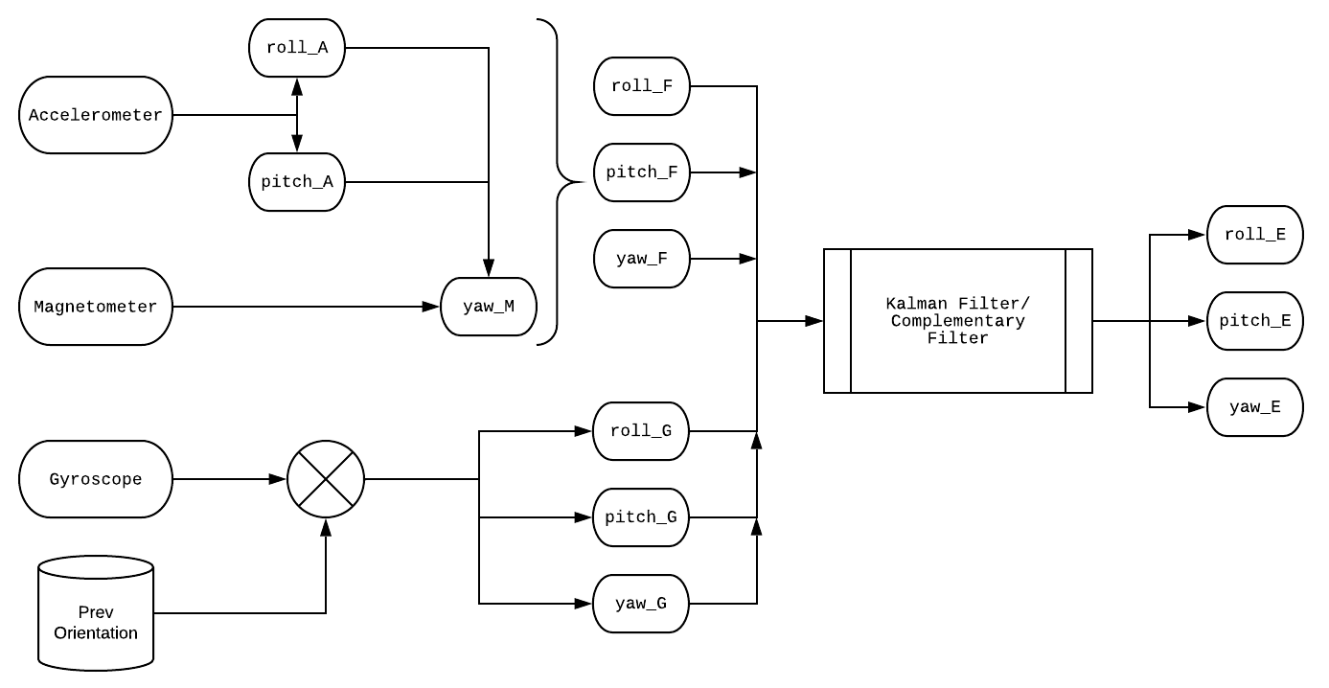
System Model

Slide 4
Complementary Filter
The low drift, high noise property of accelerometer+magnetometer and low noise, high drift property of gyroscope are combined to get reliable data.
Uses a weighted average.
Weights are adjusted by trial and error.
Weight of gyro = 0.75 & weight of accelerometer = 0.25 (in our project).

Slide 5
Kalman Filter
Noise is modelled using a Gaussian distribution
Uses a prediction-correction architecture to get reliable, unbiased estimates.
Linear Kalman Filter is implemented, since a linear motion and measurement model is used.

Slide 6
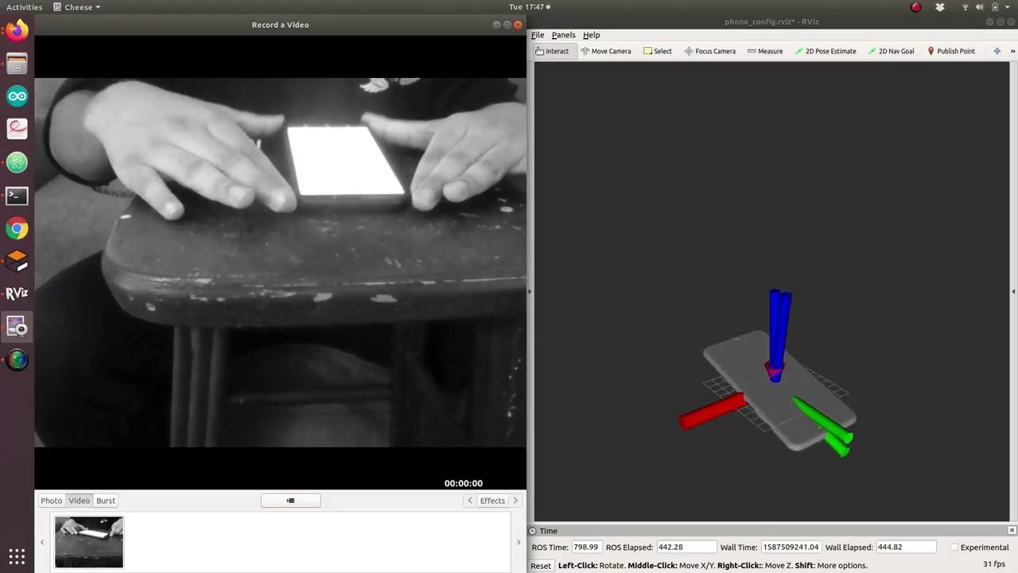
Results
Sensor Fusion using Complementary Filter

Slide 7
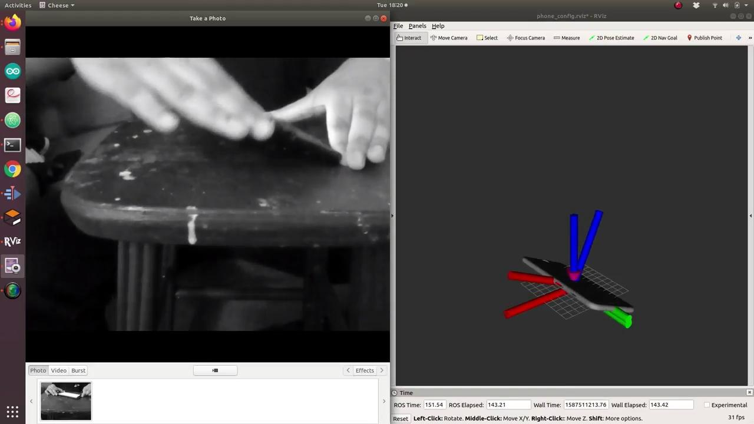
Results
Sensor Fusion using Kalman Filter

Slide 8
Benchmarking
Two Techniques:
Ground truth obtained by attaching phone to an industrial robotic arm (ABB4600).
Comparison of filter estimates with an accurate angular benchmark.

Slide 9
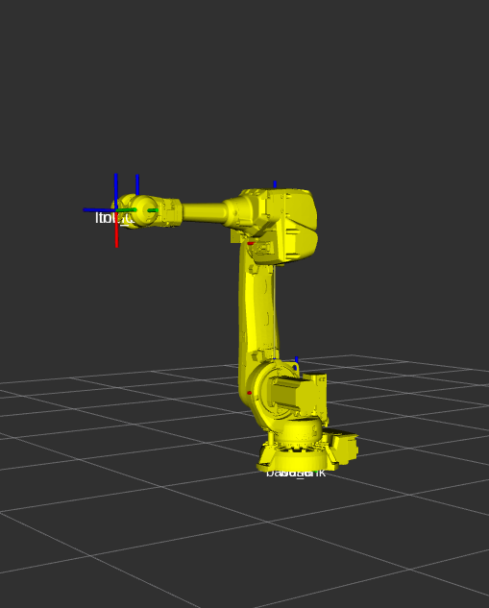
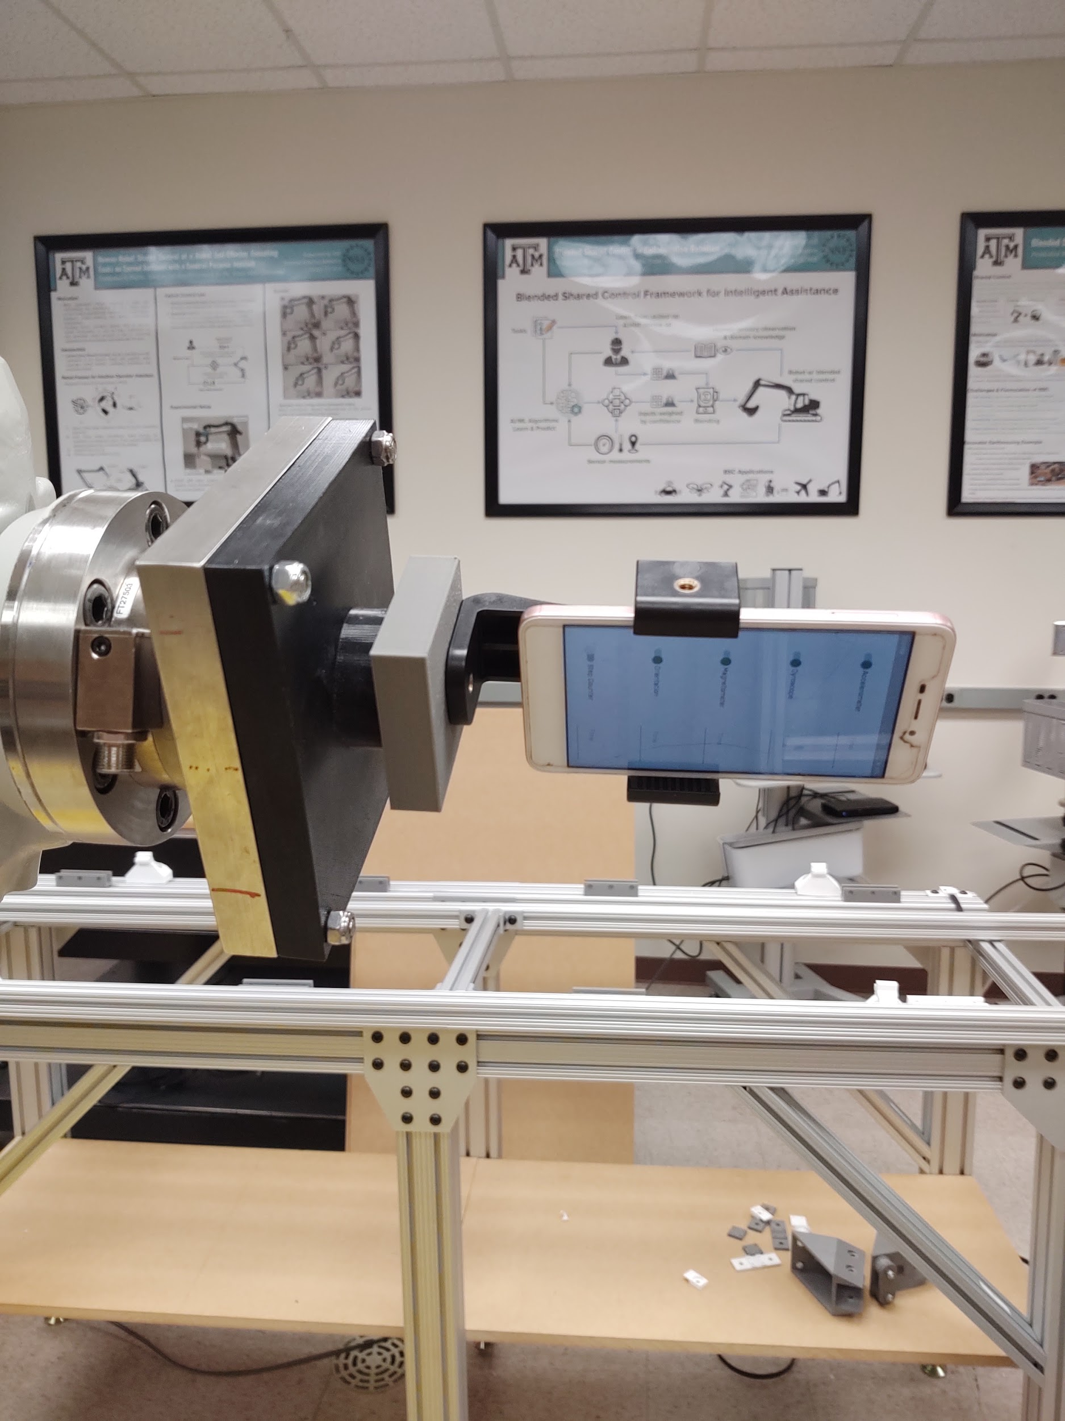
Robotic Arm Benchmarking

Slide 10
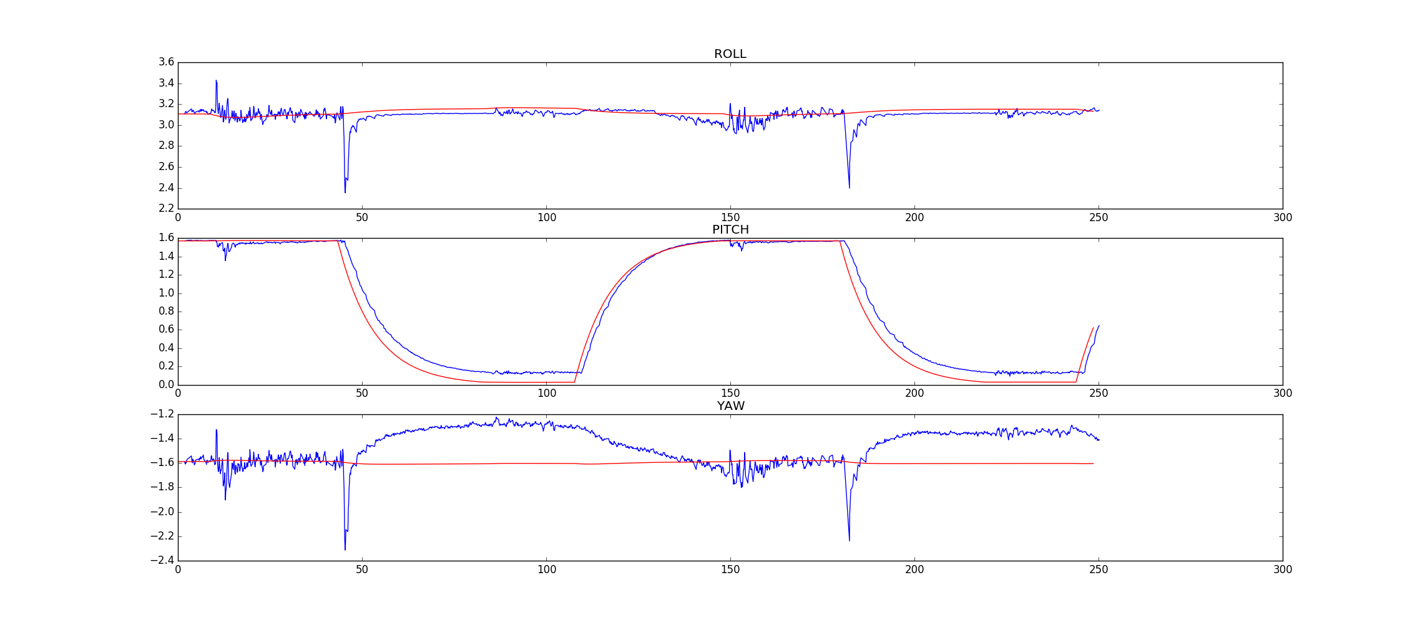
Robot Benchmarking Results
Blue- KF Red - GT from robot

Slide 11
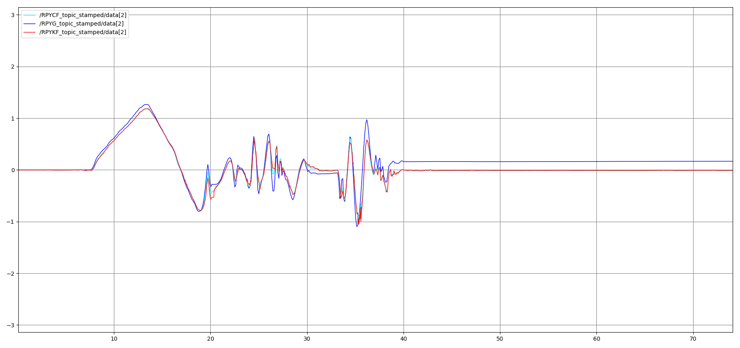
Yaw estimates with and without Fusion
(RPYG - gyro only, RPYKF - kalman filter, RPYCF -Complementary filter)

Slide 12
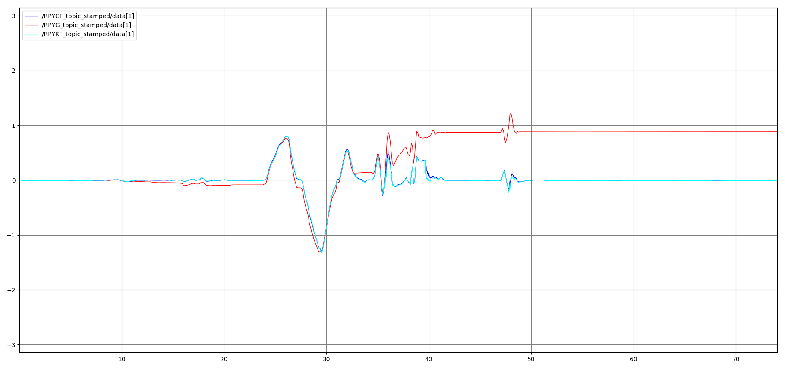
Pitch estimates with and without Fusion
(RPYG - gyro only, RPYKF - kalman filter, RPYCF -Complementary filter)

Slide 13
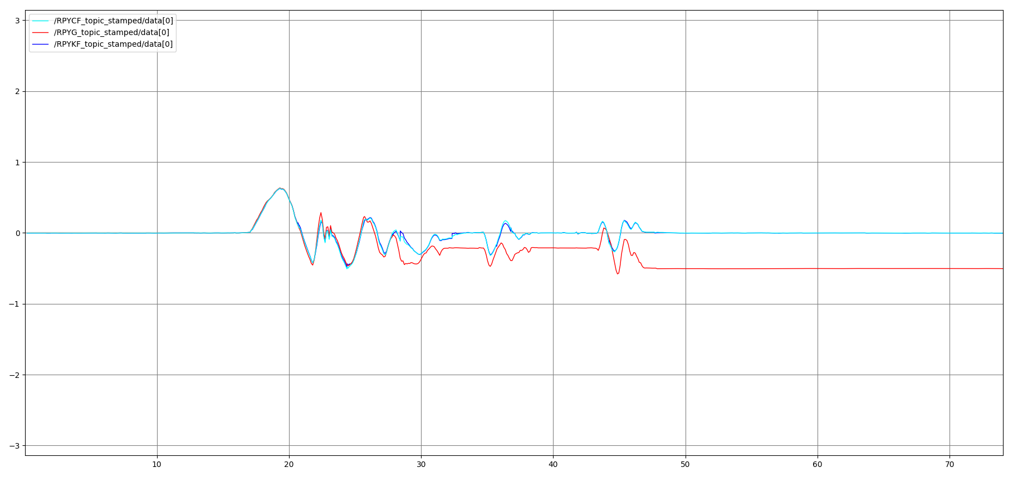
Roll estimates with and without Fusion
(RPYG - gyro only, RPYKF - kalman filter, RPYCF -Complementary filter)

Slide 14
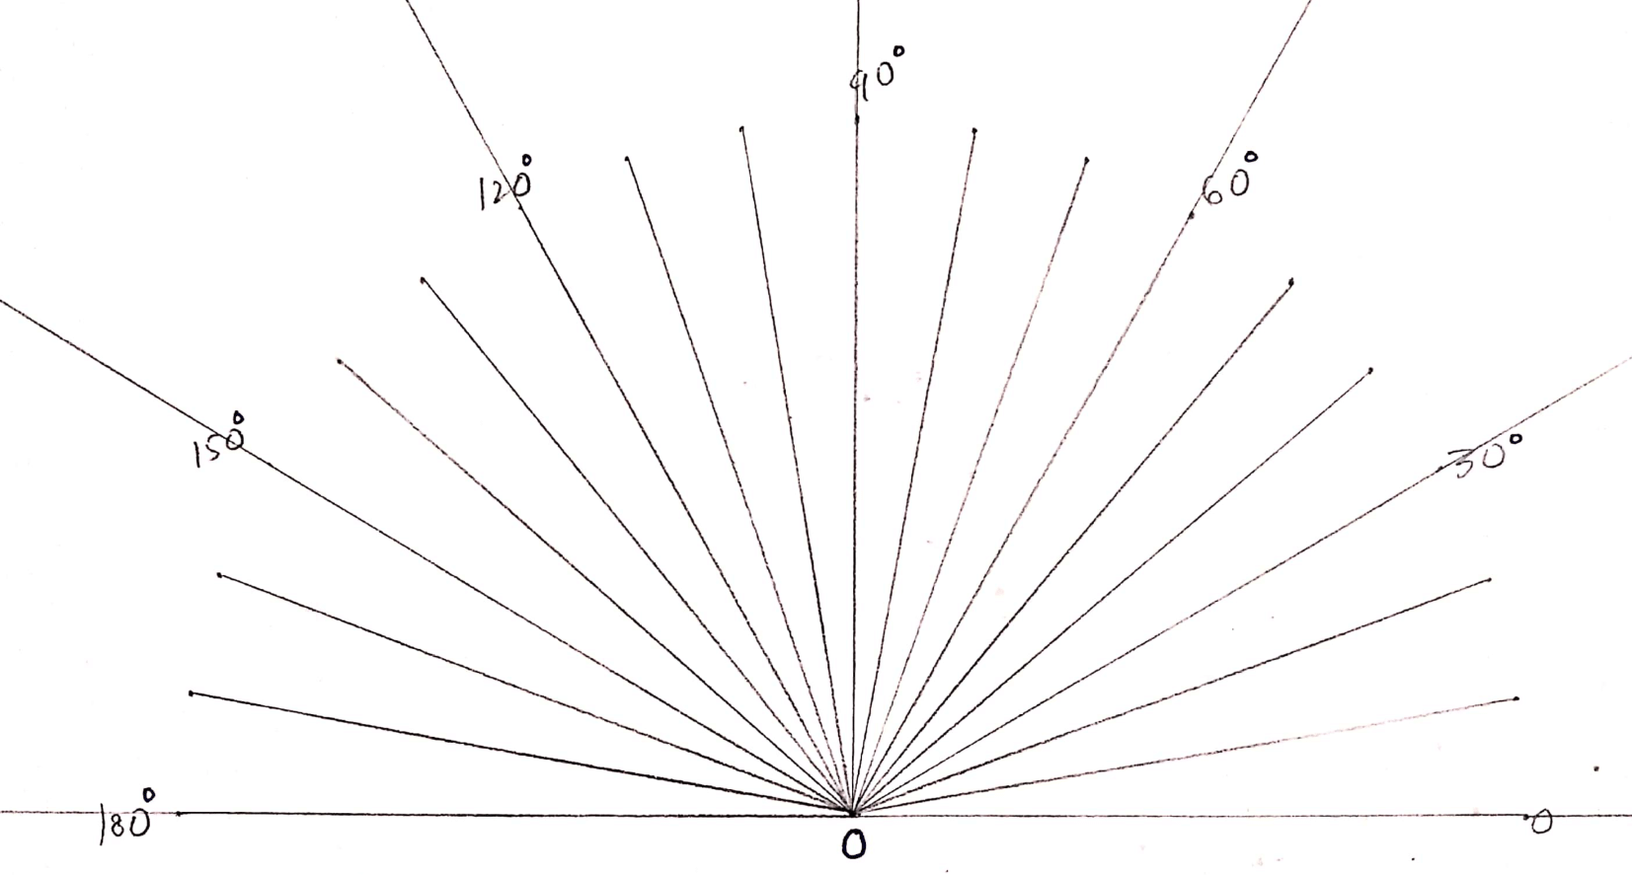
Comparison with Angular Benchmark

Slide 15
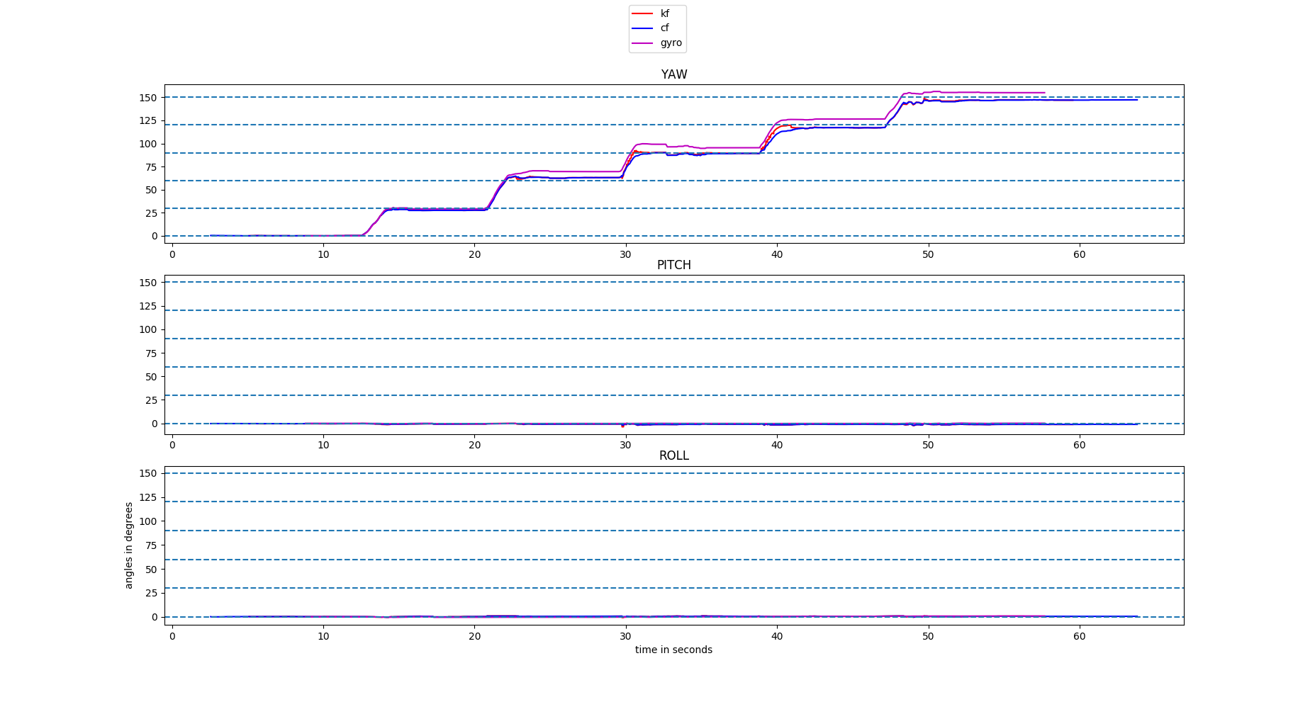
Comparison with Angular Benchmark

Slide 16
Conclusion
Relatively accurate estimates obtained from both Kalman filter and Complementary filter.
Successfully implemented a Kalman filter using real-time data from onboard sensors
Filter effectiveness has been verified by benchmarking against ground truth data.

Slide 17



